Slide 1

Level: Advanced
Game Development with Unity
Omid Saadat

Slide 2
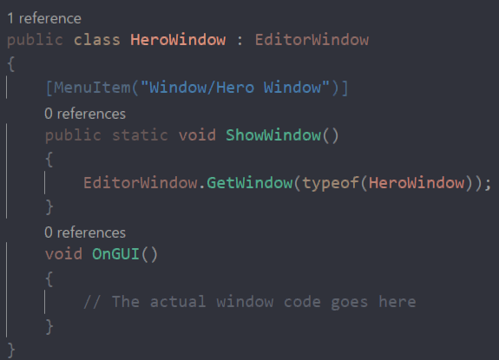
Custom Window
EditorWindow

Slide 3
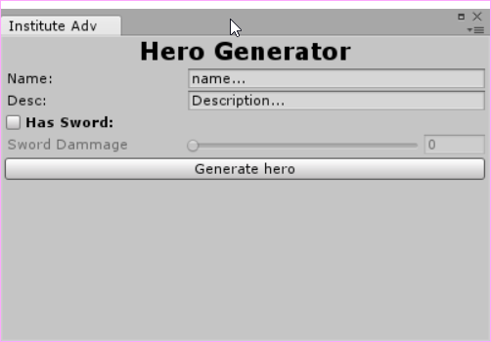
Usage:
We don’t have a class to customize.
Usually to add new features. Like node editor etc..

Slide 4
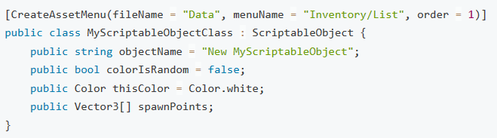
ScriptableObject
Usage
Best practices
Sample
[CreateAssetMenu()]

Slide 5
Practice
Generate and actual hero object using custom window and ScriptableObject!

